Slide 1
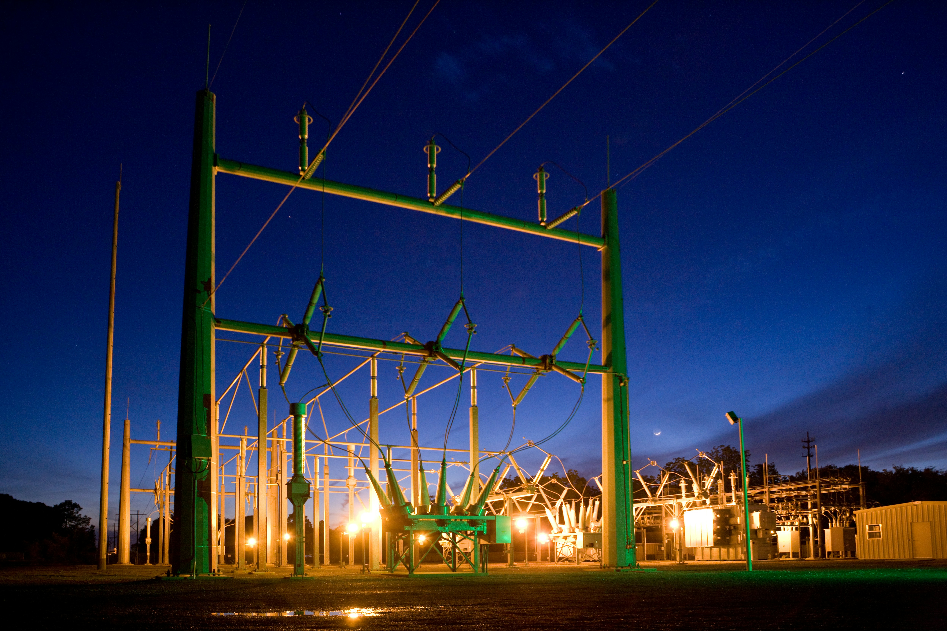
Real-Time Quality Index Estimation for Redundant Sampled Values Streams in Digital Substations
Everton Matheus Oriente
Master’s degree in Critical Computing Systems Engineering

Slide 2
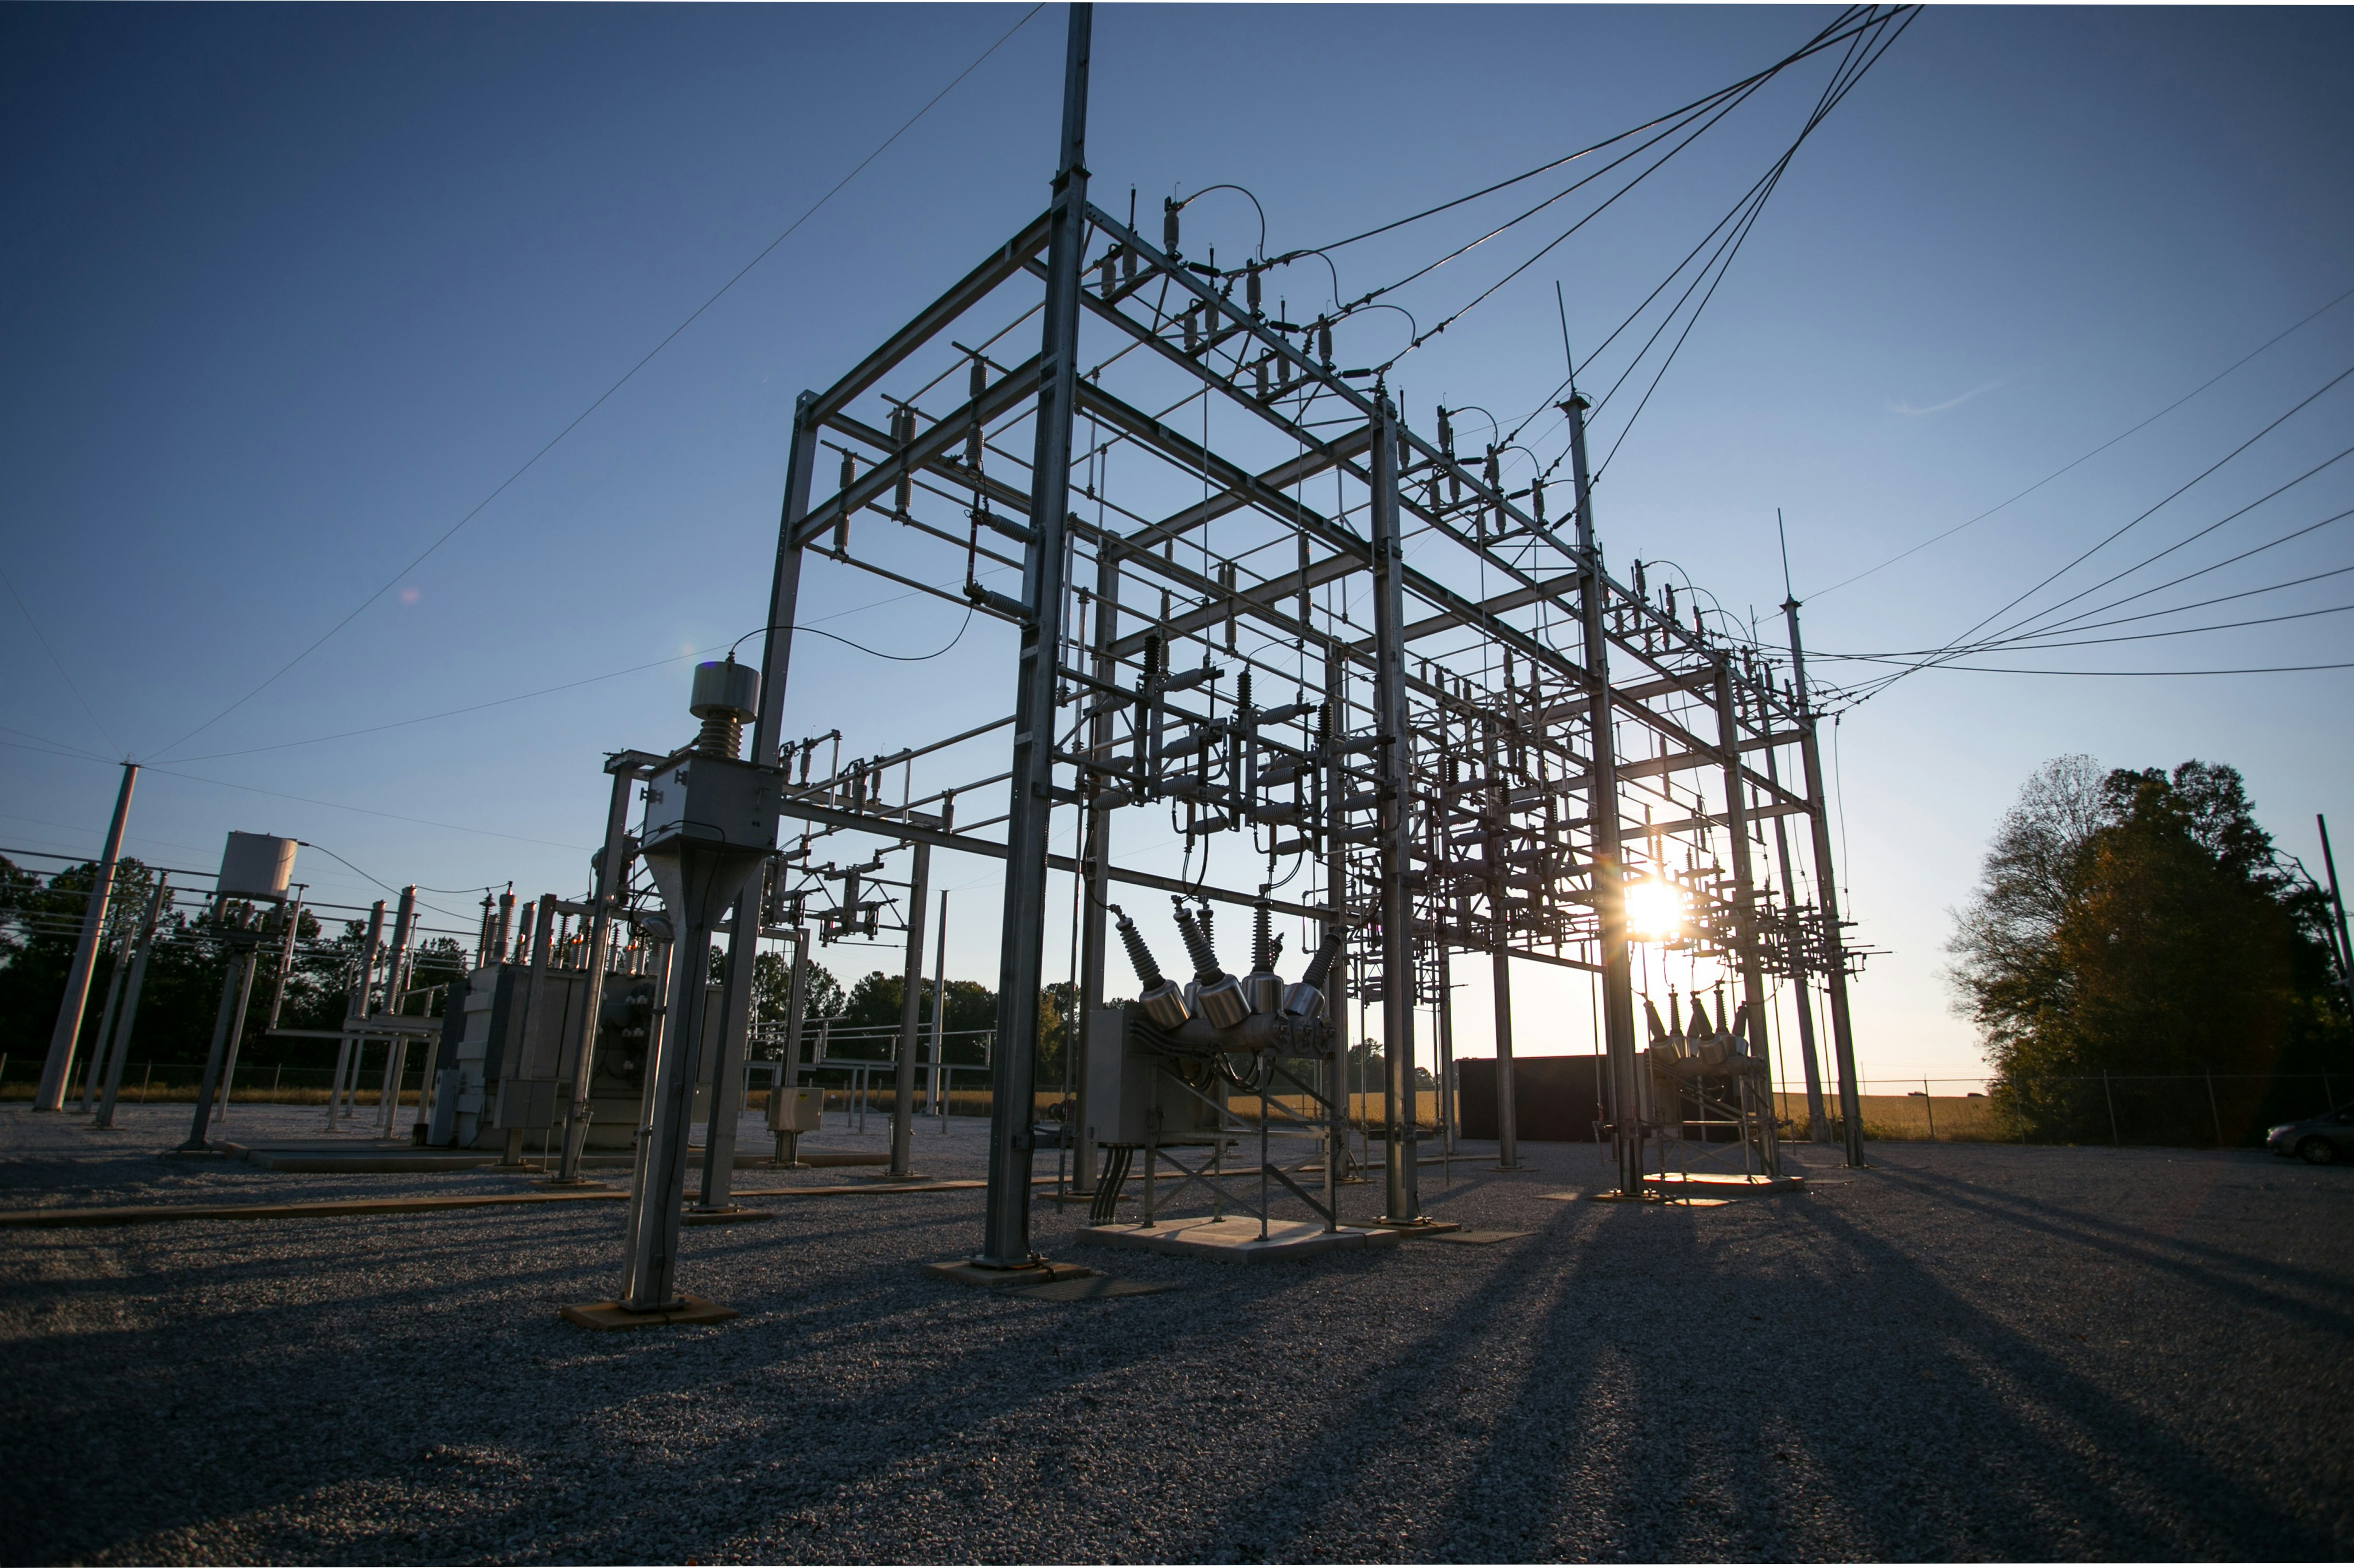
Presentation of the Problem
Overview of the challenges in substation automation
Current issues in protection systems
Need for more dynamic and reliable data sources for SVs in protection relays.

Slide 3
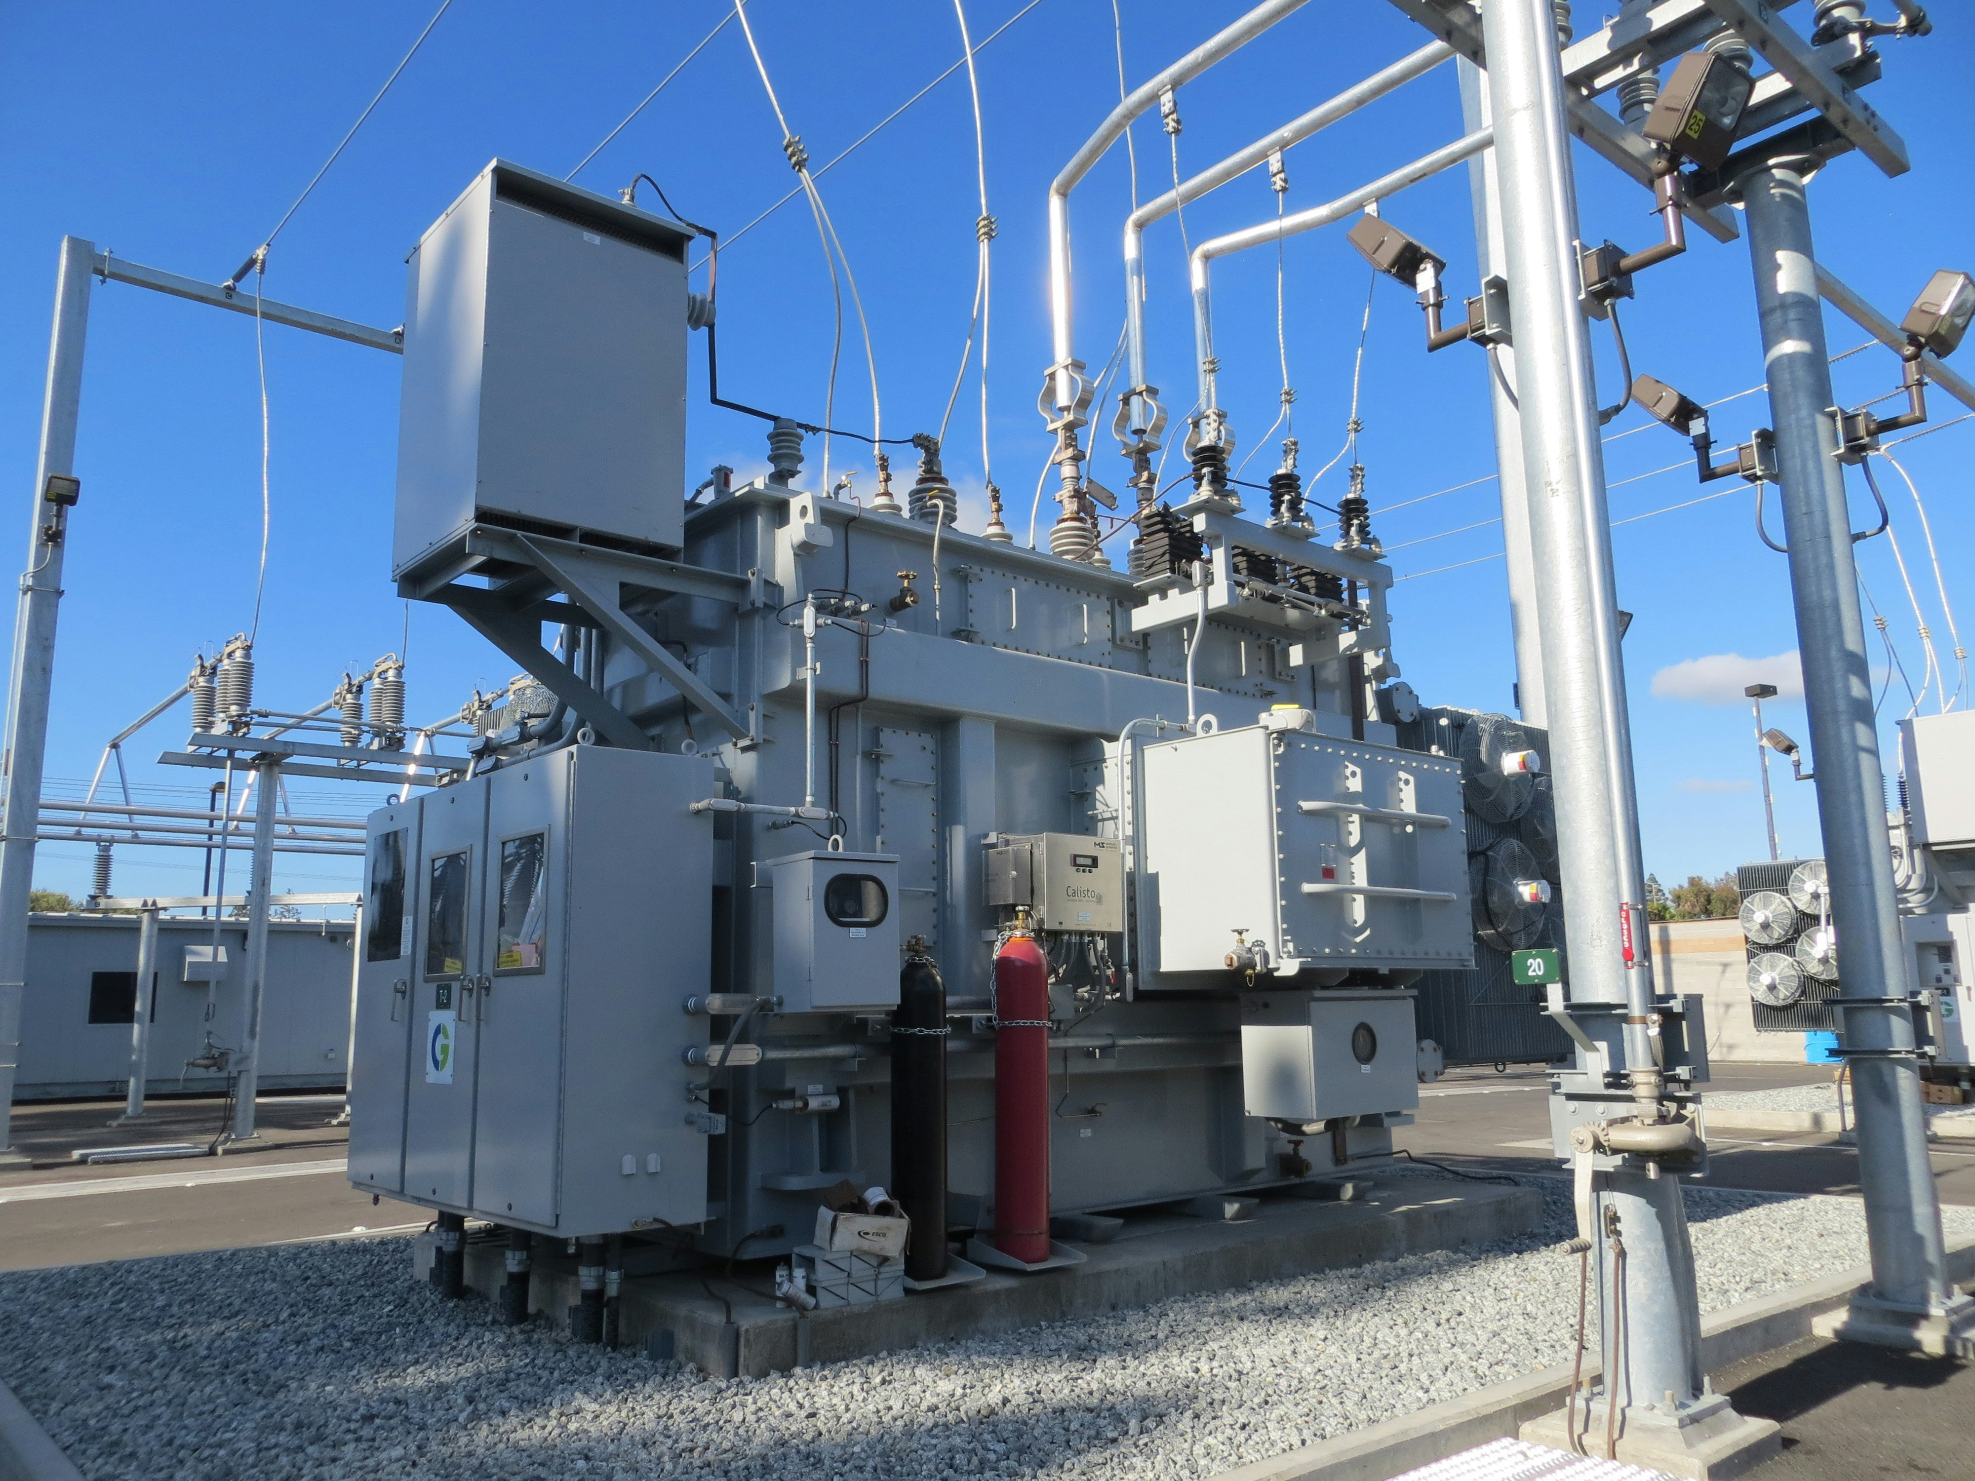
Context of Substations
Substation Automation Evolution
Transition from electromechanical relays to Intelligent Electronic Devices (IEDs)
IEC 61850 protocol and Merging Units (MU)

Slide 4
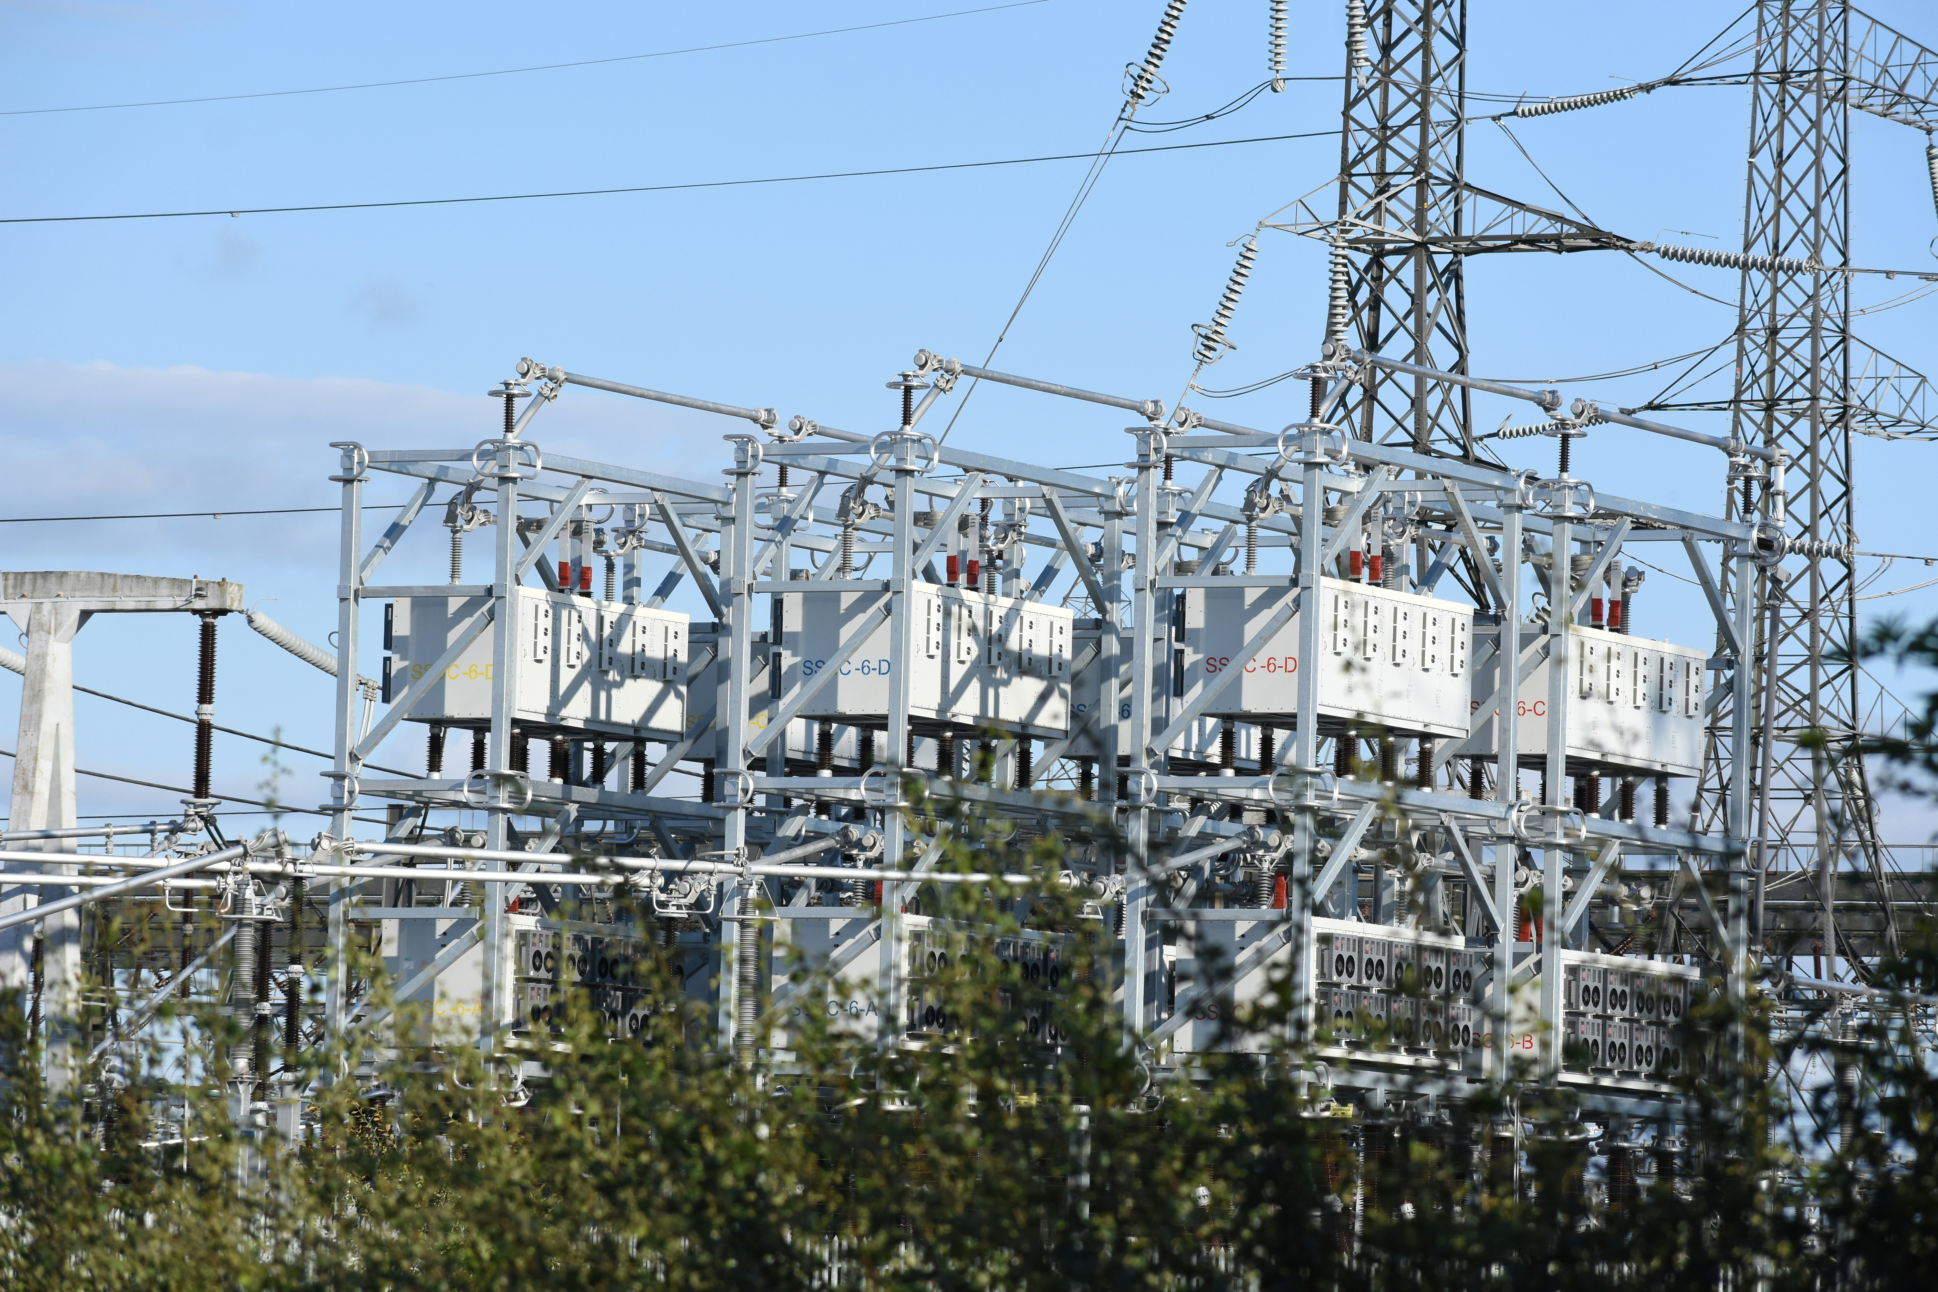
Problem Identification
Challenges with current MU systems
Reliability concerns when switching between sampled values
Inability to select the optimal Sampled Values (SV) in real-time

Slide 5
Vision of the Solution
Proposing a real-time algorithm
Developing an algorithm to select the best SV in real-time based on reliability and performance.
This ensures better decision-making in protection relays.

Slide 6
System Architecture
Overview of system architecture:
Merging Unit, Publisher, Subscriber, Protection Relay
Integration of the state machine for SV selection

Slide 7
Implementation
Development phases:
• Building the publisher and subscriber for SVs
• State machine implementation for optimal SV selection
• Error handling and synchronization improvements

Slide 8
State Machine Logic
Explanation of the state machine:
• Receives SVs from two sources
• Validates the quality of SV
• Selects the optimal SV based on predefined metrics (error rate, latency)

Slide 9
Demonstration
Testing the algorithm with both simulated and real-world signals:
• Simulated signals: using test setup with publisher/subscriber
• Real-world signals: testing with actual Merging Units and relays

Slide 10
Analysis of Results
Results:
• Algorithm successfully selects optimal SV in real-time
• Improved fault detection and faster response times in protection relays
• Demonstrated stability and efficiency in both test scenarios

Slide 11
Challenges and Limitations
Challenges faced during development:
• Synchronization issues between the publisher and subscriber
• Latency issues during real-world tests

Slide 12
Conclusion
Key contributions of the thesis:
• Developed an algorithm to dynamically select the best SV
• Enhanced the reliability of protection relays
• Contributed to advancements in digital substation automation

Slide 13
Future Work
Next steps to improve the system:
• Implement PTP synchronization for even more accurate time-stamping
• Extend the algorithm for complex multi-relay configurations
• Incorporate machine learning to predict the optimal SV in real-time

Slide 14
Question & Answers
Thanks for your attention!
Any questions?

